Slide 1

Stealth Mode: “LASER COMMUNICATOR”
By: Paul Teogalbo & Bobby Torres

Slide 2

Question
Classrooms are places where quiet studying takes place. Light, I’m pretty sure, makes NO sound. There have been countless times where the teacher is talking and the only way that I ask my neighbor for a pencil is by passing notes (with the occasional gossip), and teachers just DON’T get that we have a social life too.
Isn’t there an easier way?
Why not use something as simple as light to secretly communicate across the room WITHOUT getting caught?

Slide 3
Hypothesis
A simple way to combat this problem is communicating through the convenient use of a simple laser pointer and a solar cell. If a laser can travel forever at such high speeds, in pulses, why can’t it carry something as simple as sound?
We believe it is possible to achieve this. By the use of a laser and a solar cell, we can convert sound into a form of light energy, capable to be transported across vast distances through a laser beam, and received by a solar cell, and finally converting back into electrical energy which is sound and audible to the human ear.
We hypothesize that the laser beam will be able to penetrate through transparent objects but will completely be obstructed by translucent or solid objects.

Slide 4
Materials
Item | Price
Laser Pointer | $.99 @99cents Store
Solar Cell* | $.99 @99cents Store
Audio-Output Transformer | $2.99 @ RadioShack
Alligator Clips (4x) or wire | Stolen from Mr. Chambers
Double “AA” Batteries (3x) | $3 @ Rite Aid
3.5mm Jack cable (male both ends) | $.99 @99cents Store
Amplifier/Speaker | Free from the Flea Market
*option 2: Photo-Resistor(6-pack) | $2.99 @RadioShack
These are basically the materials that we need. Each are quite cheap however the alligator clips were quite expensive.
Notes:
ok we're done
nite bobby
good nite !!

Slide 5
Procedure
Obtain all required materials
Insert batteries into the battery pack (3).
Remove the batteries from the laser pointer.
Attach the alligator clips to their respective terminals(polarity) and connect the correct clips to the audio output transformer on the side where there are two wires. (red and white)
Attach the battery pack between the audio output transformer and the laser.
Cut the 3.5mm cable in half and connect wires (green and blue) to the audio output transformer. Leave the black wire alone.
Use other 3.5mm cable and connect it to the solar cell. (Consider the correct polarity)
Plug the receiver end to the amplifier and plug the transmitter end to a sound output device.

Slide 6
Procedure-cont.
8. Power on the amplifier and point and aim the laser towards the solar cell.
9. Turn on the sound output device and play a sound/song.
10. Place various types of objects between the laser beam and solar cell.
11. Observe and record the results.

Slide 7
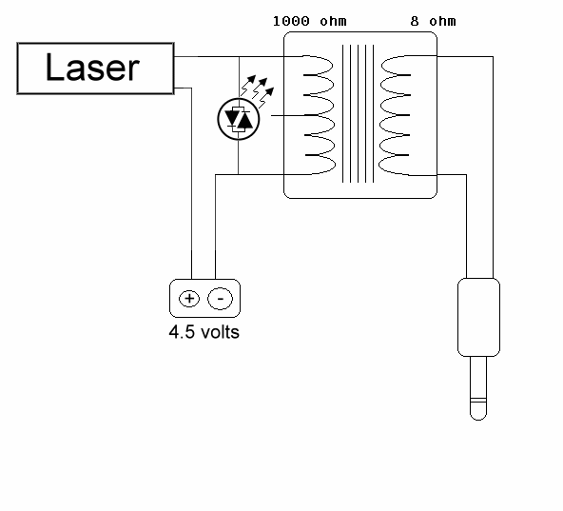
Diagrams-Skematics
Audio Output Transformer
battery
Transmitter side
3.5mm jack to sound device

Slide 8
Diagrams-Skematics cont.
+
-
3.5mm jack to amplifier
Solar cell/panel
Receiver side

Slide 9
Pictures

Slide 10
Observations
Item | Penetrates? (Yes or No?)
Wine Glass | Yes. Partially penetrates. Muffled sound.
Poly-Carbonate Cup | Somewhat penetrates. Some sound is distorted
Paul's Glasses | Yes. Completely penetrates.
Cellophane | Yes. Completely penetrates.
Cellophane ball | Somewhat. Sound is emitted but not to audible.
8x11 Paper | Yes. Partially penetrates when closer to receiver end.
Light Bulb Off | Yes. The sound is audible and is heard.
Light Bulb On | Somewhat. Surprisingly, the light particles interfere with the laser beam and the sound is distorted.
Notes:
i found our WITTY ending
lol

Slide 11
Theory
Unlike a normal light (such as a flashlight), in which the light particles are spread out, disorganized, and weak, the laser beam is generally a concentrated and organized state of light particles that move completely "in- step" with one another. This creates a centralized and strong beam of light.
As for solar panel, a seemingly confusing explanation is actually quite simple. Underneath these panels lie silicon. Since silicon has four electrons in its outer shell, and it can hold eight, it captures four more from the sun. This causes it to combine with the phosphorus in the panel. This makes one electron separate, called free carriers, that carries a current. In lame man's terms, solar panels absorb certain frequencies of light and covert them in to electrical energy.

Slide 12
Theory, cont.
The main purpose of the audio output transformer is "impedance matching." Simplified, this kind of just means to give the maximum amount of power output possible to create the "best" sound. The input and outputs are known as "windings." The input is the primary winding and the output is the secondary winding. The primary winding creates a magnetic field to fluctuate the sound, and the secondary winding is a current generated by the magnetic field to keep the input flowing to the output. The "impedance" can fluctuate from 600 ohms to up to 20,000 ohms of power.

Slide 13
Conclusion
How the "laser communicator" works: -Electrical energy(sound) is converted to light energy through the audio output transformer and to the laser. The electrical energy pulses the laser beam to produce various types of wavelengths/frequencies. -When the laser beam hits the solar panel, the light energy is converted back into it's original electrical energy to produce sound in the amplifier/speaker.
This type of "laser" communication can be utilized in the future wheras more powerful lasers and larger photorecptors(solarcells/photoresistors) can make it a more practical and effective means of communication globally which can convert sound messages into light and visa-versa.
Thus, creating a super awesome fool- proof way to talk during class WITHOUT getting in trouble. HAHAHA! "What are you talking about Mr. Chambers? How can I be talking to Paul, he's way over there!"
Notes:
lol
ur still here?
yep
i found our WITTY ending
paul?
wut?

Slide 14
Sources
http://www.make-digital.com/make/vol16/?pg=69#pg69 -Provides instructions on how to assemble the laser communicator
http://www.youtube.com/watch?v=HKRPfa66_po -Provided inspiration for the idea of the project
http://scitoys.com/scitoys/scitoys/light/light.html -Provided an alternative and a more in depth directions for the assembly of the laser communicator
http://science.howstuffworks.com/laser4.htm
-The basics of a laser beam
http://www.solarhome.org/infohowdosolarpanelswork.html
- This is how a solar panel works
http://www.answerbag.com/q_view/273774
- This one's for the Audio Output Transformer
Notes:
no
sammybat is my old rs usurname
not sammybatquest
wait
OH YEAH!!!!!
that's my old email

